Slide 1

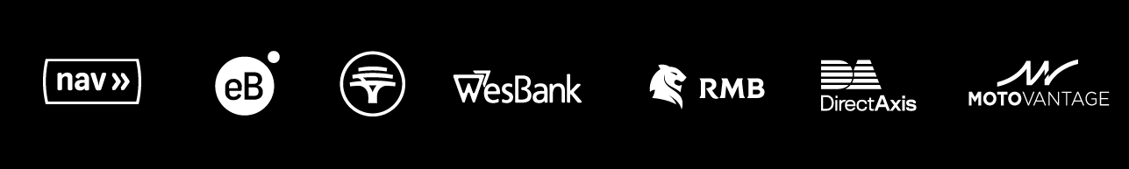
Elite Wealth and Commspace Data Migration Roadmap and Capability Ownership
SQL07 to the Platform – February 2026

Slide 2
Elite Wealth Data Migration to the Platform
The solution will be presented in two parts:
What we are solving for
Our approach

Slide 3
What we are solving for:
The SQL07 Migration aims to bring the data products that are currently on SQL07 to the platform for use across the bank.
Our responsibility is to migrate the Elite Wealth and Commspace Generation 1 data products.
Some helpful definitions:
Data Product (from our DataWiki): A Data Product is curated data, data that has undergone a process of organisation and/ or integration from various sources. It involves the annotation, publication and presentation of the data such that the value of the data is maintained over time, and the data remains available for reuse and preservation. It is where the organisation’s trusted information, documents, digital assets, and any other content types are stored.

Slide 4
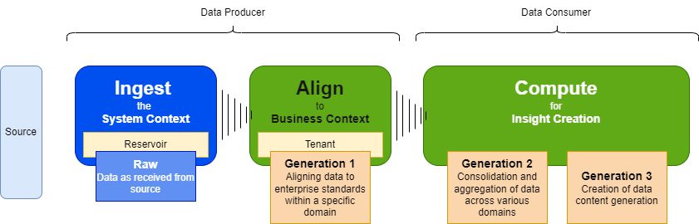
What we are solving for (definitions):
The organisation defines three different types of data products (adapted from the platform conceptual data pipeline (conceptual architecture)):
As Data Producer Integrated Advice owns the Raw data and Generation 1 data products.
Generation 1 data products do not include transformations and calculations, but are the raw data modelled to align to enterprise standards within a specific domain.
As Data Consumers the BI Teams own any Generation 2 and 3 data products – this is where the aggregations, transformations and consolidations happen across various domains.

Slide 5
What we are solving for (definitions continued):
The business have requested that we also provide an additional layer, a 1.5 that brings together the important data points in a standard way. There is a need for meaningful, trusted, curated data for Advice related reporting. A single source of Advice insights.
This will sit between layers 1 and 2 and will consist of consolidations and aggregations within the Elite Wealth domain.
This layer will be used by the Data Consumers across the bank as a foundation to build their Generation 2 and 3 data products.

Slide 6
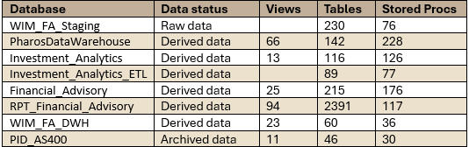
What we are solving for (DBs):
There are 8 DBs on SQL07 that contain Elite Wealth and associated derived data (including one for the AS400 data)(data as at 2024/01/08):
Questions:
Who is using all this data?
There is a lot of duplication. Does all this data and all its associated processes need to be migrated?
There are no clear answers to these questions as the people who created the data and processes have moved on.

Slide 7
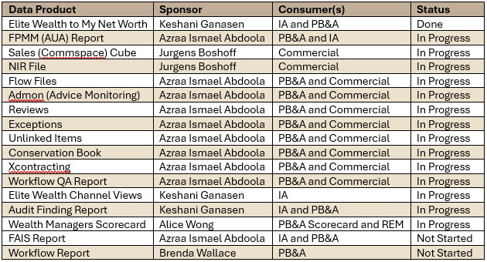
What we are solving for (data products - Pharos):
The 18 second generation data products identified for migration from Pharos are as follows (data as at 2025/06/20):

Slide 8
What we are solving for (platform factors):
The following factors must also be considered:
As data producers we don’t own the entirety of the DBs – we are only responsible for Generation 1 portion of the data.
Our business has requested an additional later to ensure the standardisation of the data across the bank – Generation 1.5. The data consumers will build their reporting on this new layer.
We won’t use the Single Data Pipeline or the EDW as we don’t own the investment and risk product data models, and the product owners are not yet on platform. This means the data will be stored in the Integrated Advice Tenant. *
* Costs for using the data are born by the consumers not the producers.

Slide 9
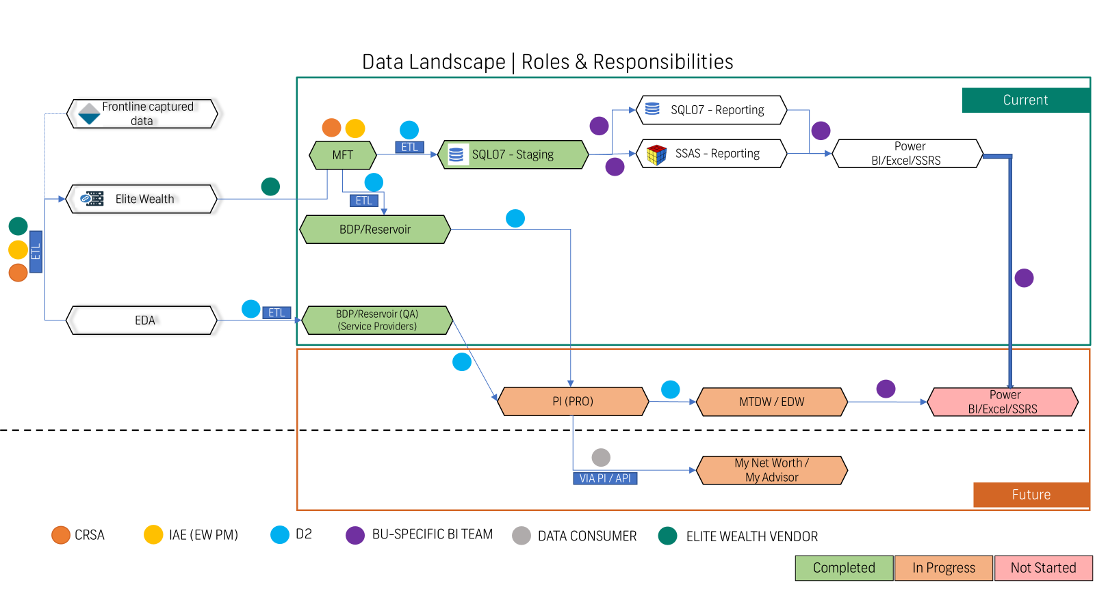
Appendix 1 – Current RACI:
Producing a new generation 1 of the data will solve some of these challenges – we ask the rest of the bank to move their processes over to this new dataset.

Slide 10
Thank you

